Slide 1



Cyber Security
Team: HANDEL
Team member: Youwei Xiao, Chuanjian Deng, Haixuan Zhu, Nianting Ouyang, Xiaoyu Wang
Project Instructor: Prof. W. “RP” Raghupathi, Prof. Yilu Zhou

Slide 2

Abstract
Modern societies have a growing dependency on information and communication technologies that are globally interconnected. However, this interconnectivity also creates risks that need to be managed at the national and international levels.
For the purpose of cyber security management, each country implemented its own cybersecurity strategy documents. The aim of the project is combining all documents and classifying sentences of them into categories according to their contents of cyberwellness.
Notes:
Modern societies have a growing dependency on information and communication technologies that are globally interconnected. However, this interconnectivity also creates interdependencies and risks that need to be managed at the national, regional and international levels. Enhancing cybersecurity and protecting critical information infrastructures is essential to each nation's security and economic well-being.
At the national level, this is a shared responsibility requiring coordinated action related to the prevention, preparation, response, and recovery from incidents on the part of government authorities, the private sector and civil society. The formulation and implementation of a national framework for cybersecurity requires a comprehensive approach. This framework often receives a label of a National Cybersecurity Strategy (NCS).
National Cybersecurity Strategies, however, do not always take the form of a single, aptly titled, document; certain states chose a fragmented approach and decided to address different cybersecurity areas via multiple different instruments. Together, they form a National Cybersecurity Strategy. At the same time, strategies may receive a designation other than a National Cybersecurity Strategy. Documents titled, for example, National ICT Strategy or National Cybersecurity Masterplan should not be disregarded. What is more, certain states have multiple strategies.

Slide 3
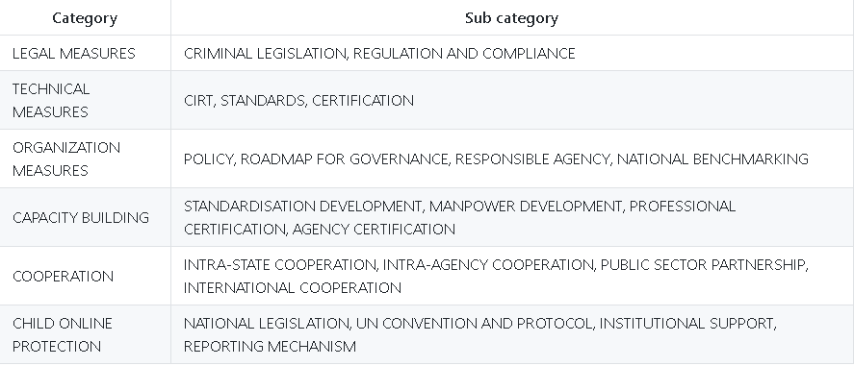
Introduction

Slide 4
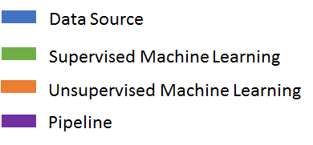
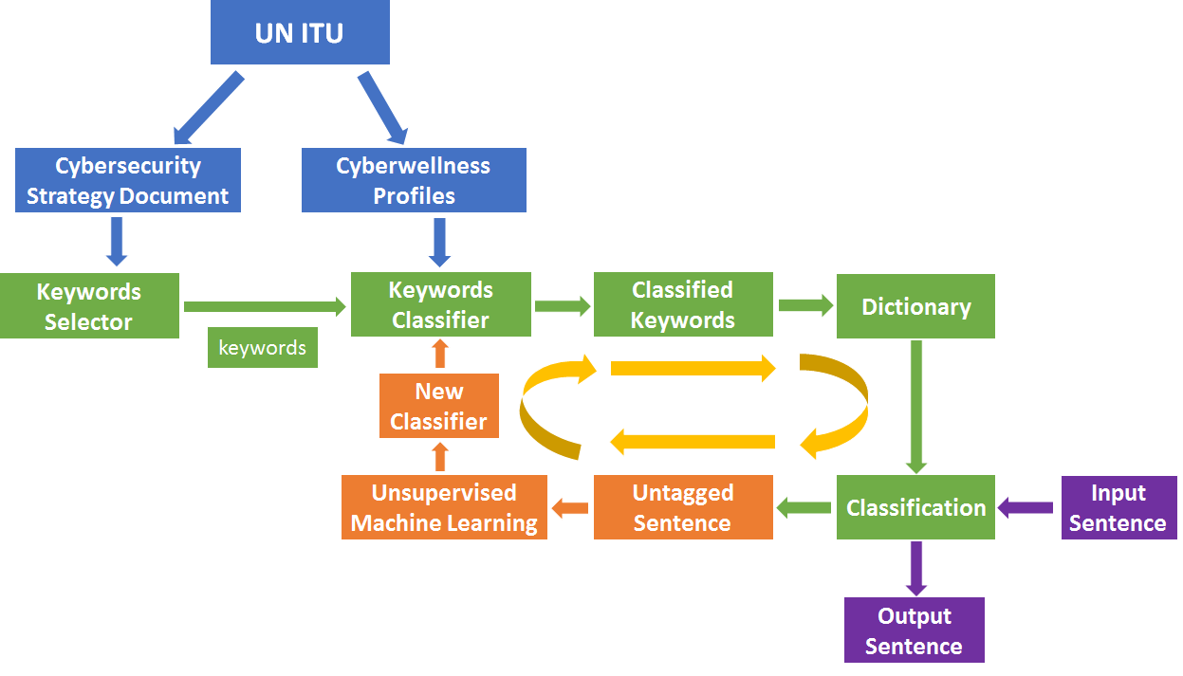
Methodology

Slide 5

Keywords Selector
Raw
One Word
Keywords
Selector
P
O
S
Two Words
Three Words
Keyword Candidates

Slide 6
Keywords Classifier
Definition Material
Quantitative
Model
Classified
Keywords
Definition Domain
1
2
3
...
19
20
21
Vector
Keyword
Candidates
Fre1 | Fre2 | …... | Fre20 | Fre21

Slide 7

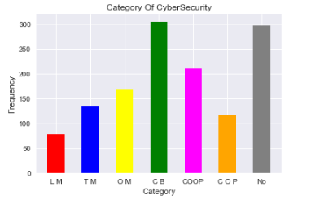
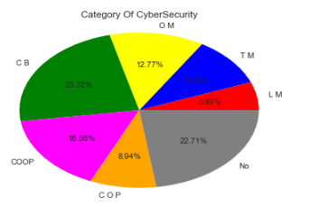
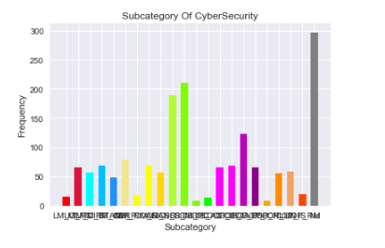
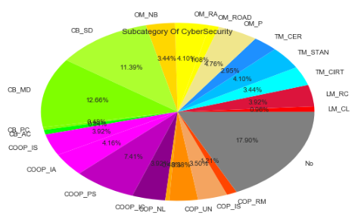
Demo: Visualization

Slide 8

Thanks
Q&A

